Slide 1

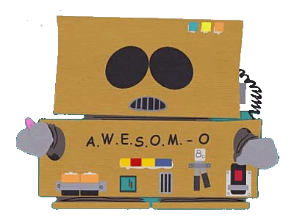
Your Robot Friend - Alexa
Keith Chester
@thekeithchester
ALEXA

Slide 2
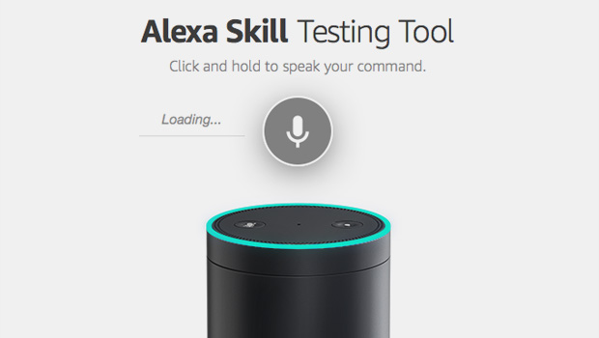
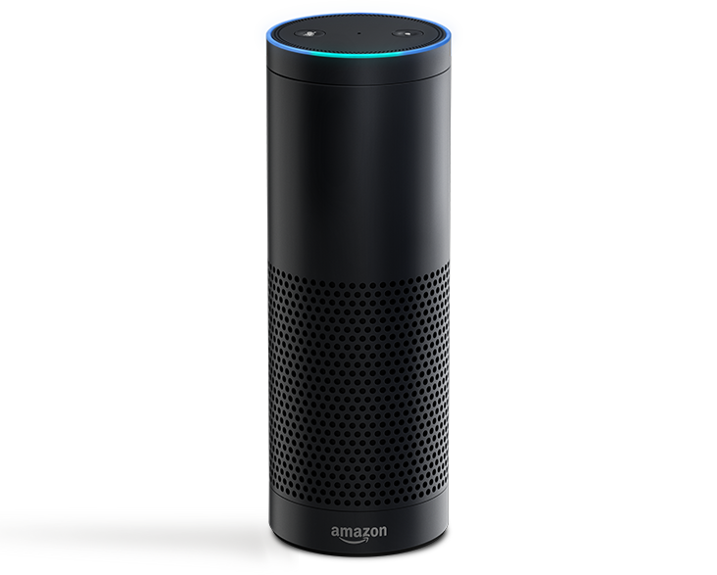
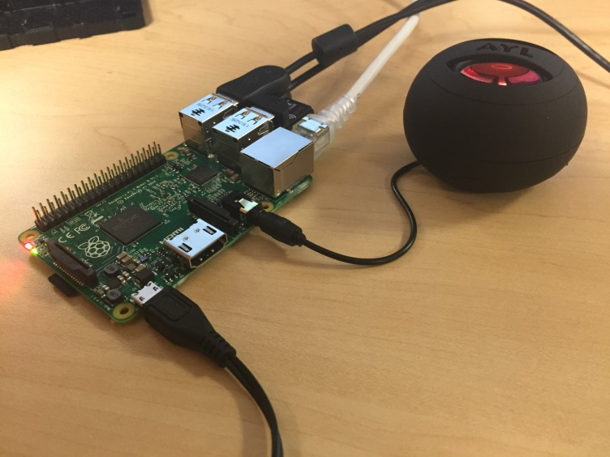
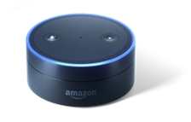
Echoechoechoecho
http://echosim.io
https://github.com/sammachin/AlexaPi

Slide 3
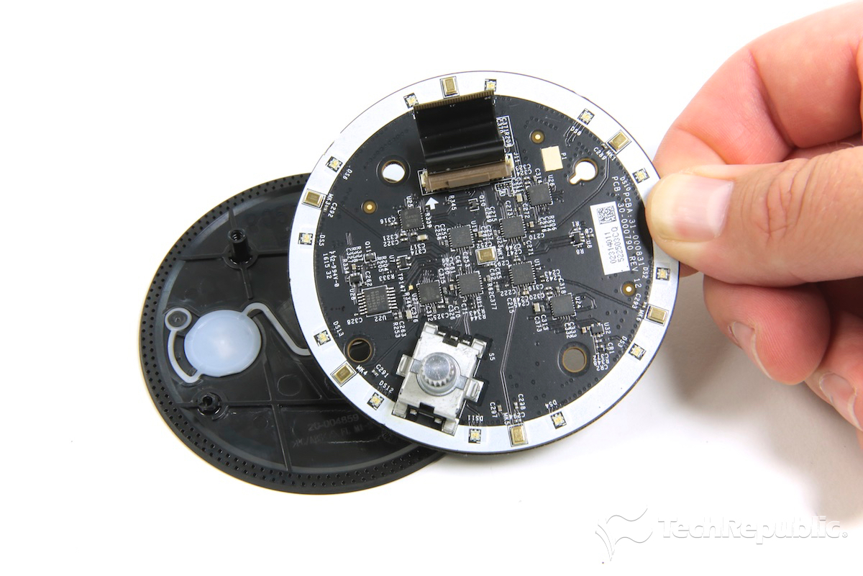
The Internals

Slide 4
Two kinds of “skills” aka mini apps
Custom Skill
Smart Home Skill
“Tell [appname] to [stuff]”
“Ask [appname] [stuff]”
“[Get info] from [app]”
Conversational UI – more on this later
“Turn on toaster”
“Turn down the thermostat”
“Dim the lights”

Slide 5
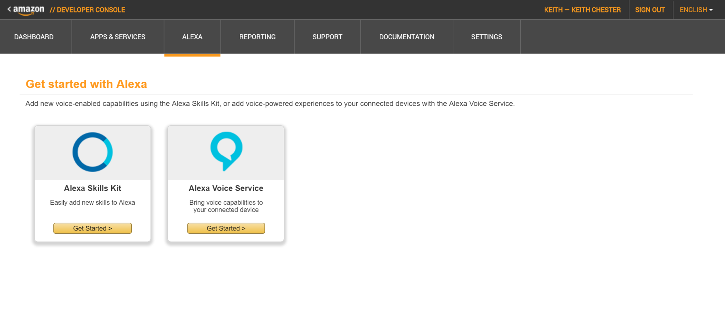
To Begin : Amazon Developer Console

Slide 6
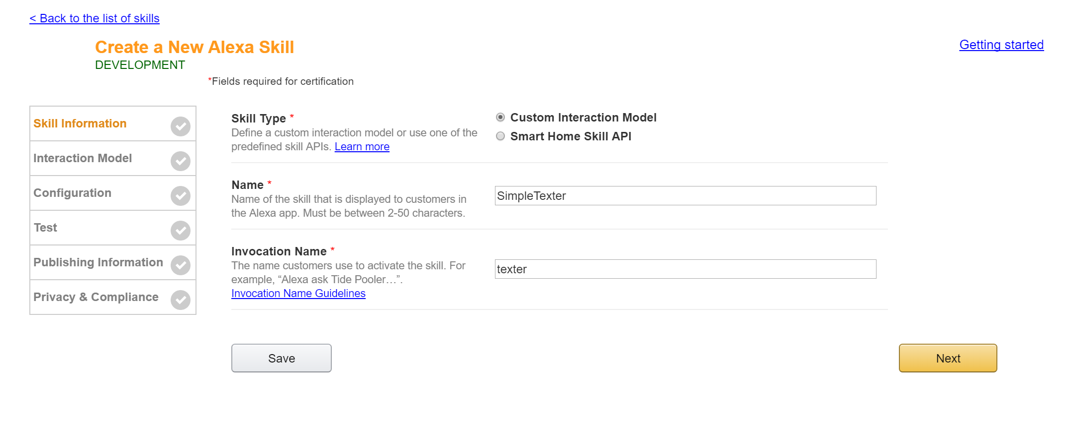
Set up the skill – and your trigger

Slide 7
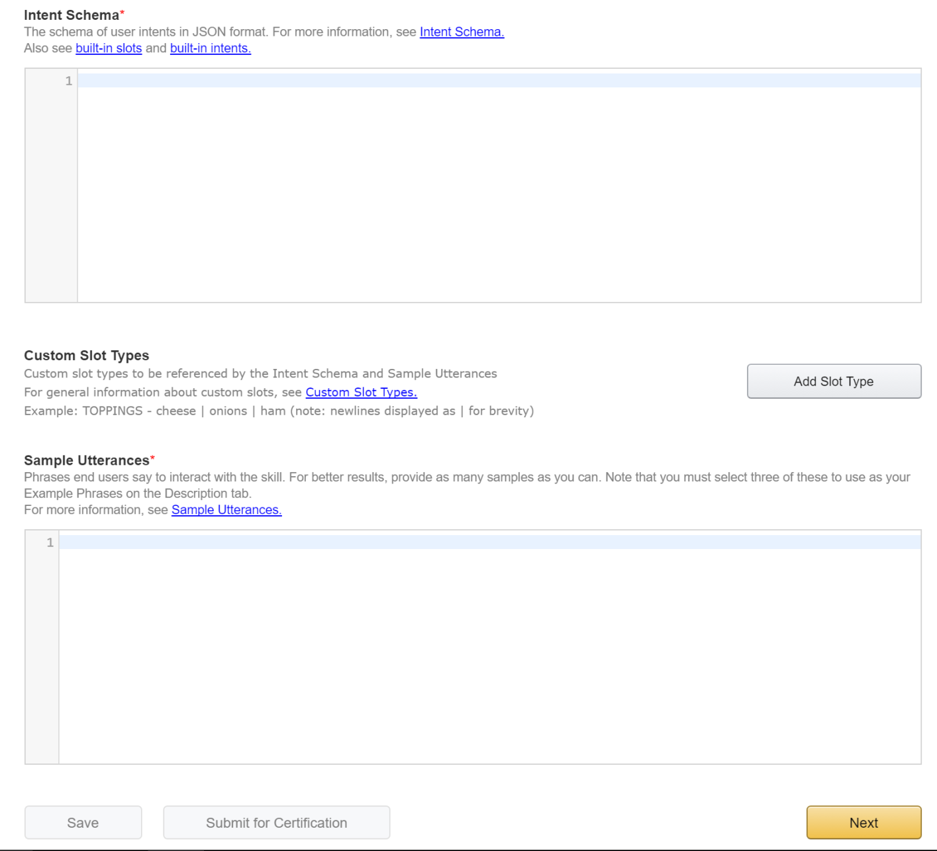
Interaction Models

Slide 8


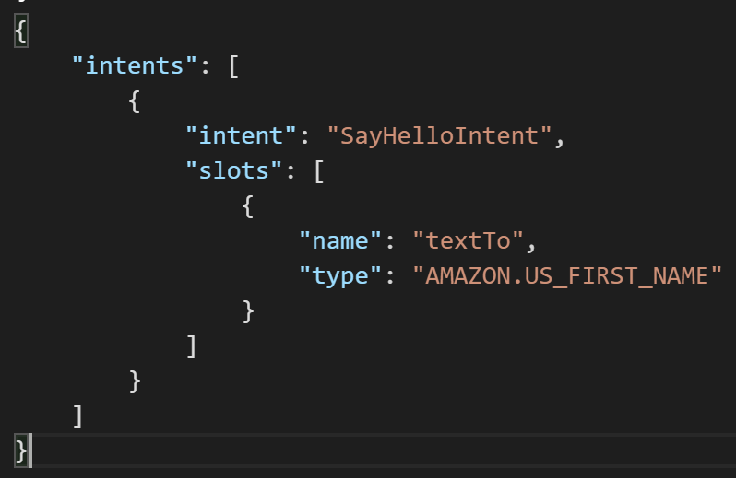
Intents + Slots
An intent is an action the user can do on your skill
A slot is an expected input for that intent

Slide 9
Built in slots
AMAZON.DATE
AMAZON.DURATION
AMAZON.FOUR_DIGIT_NUMBER
AMAZON.NUMBER
AMAZON.TIME
AMAZON.US_CITY
AMAZON.US_FIRST_NAME
AMAZON.STATE
AMAZON.LITERAL

Slide 10
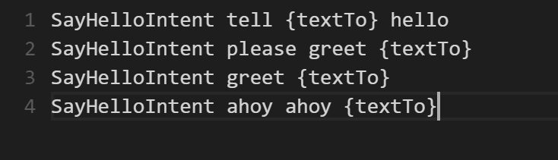
Sample Occurences
These will map intents for your skill to sample utterance
Use {slot name} to reference which areas slide into slots. Slots are not required and you can have multiple

Slide 11
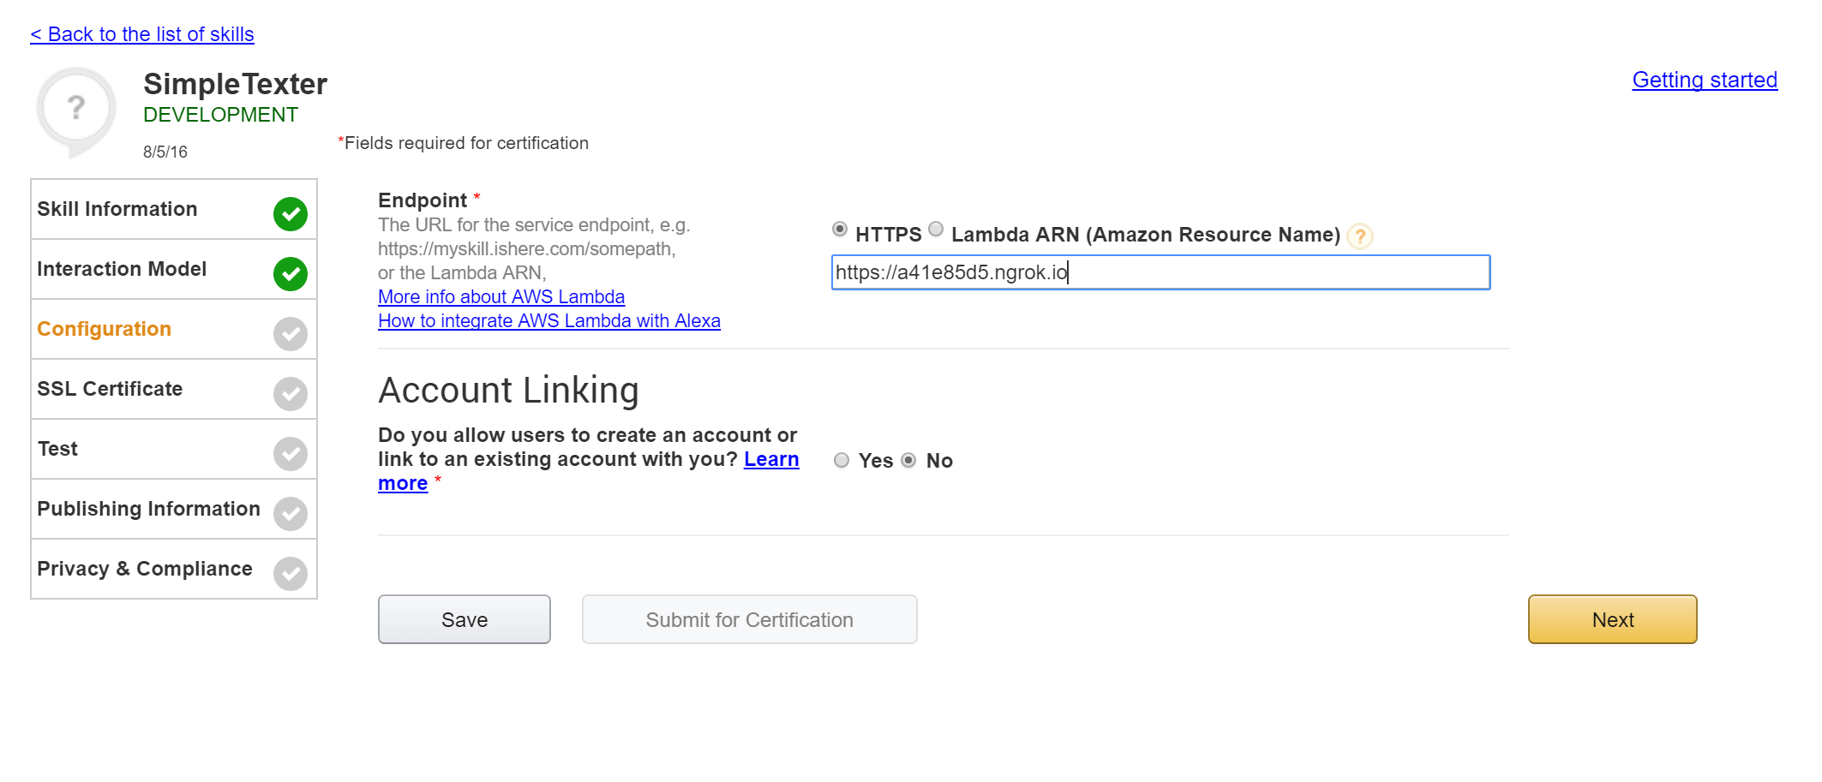
Putting it together + testing!

Slide 12
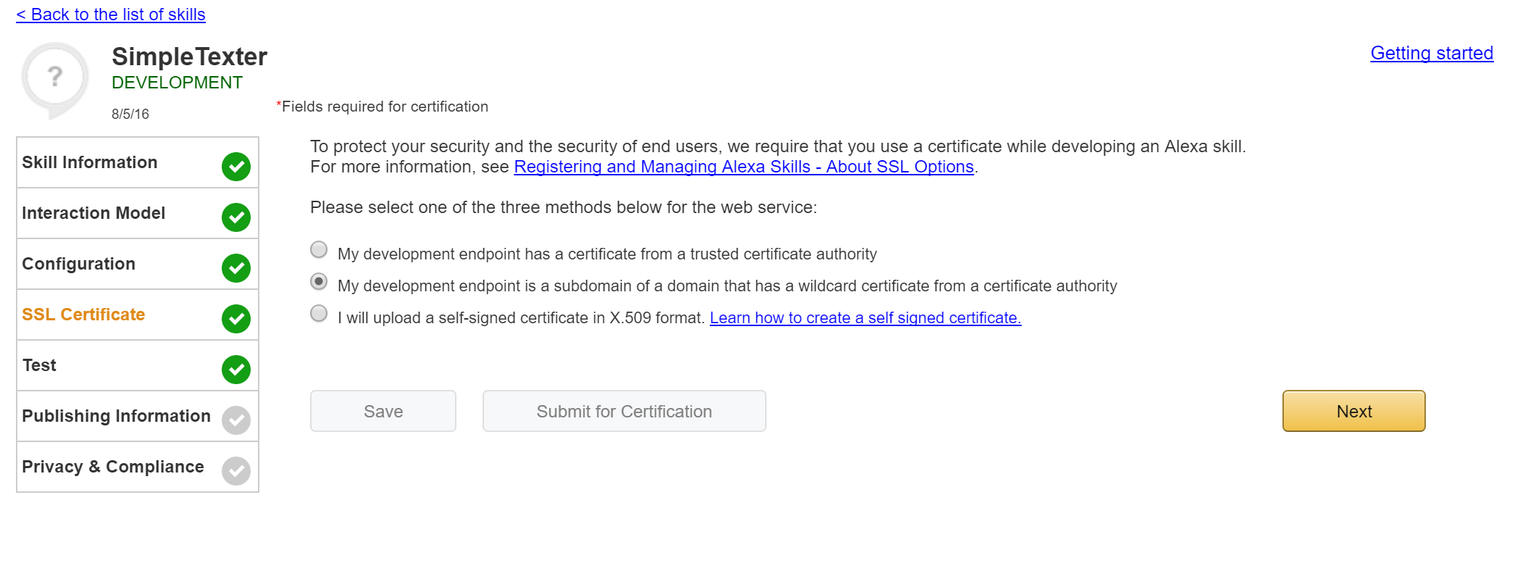
And if you’re using ngrok…

Slide 13
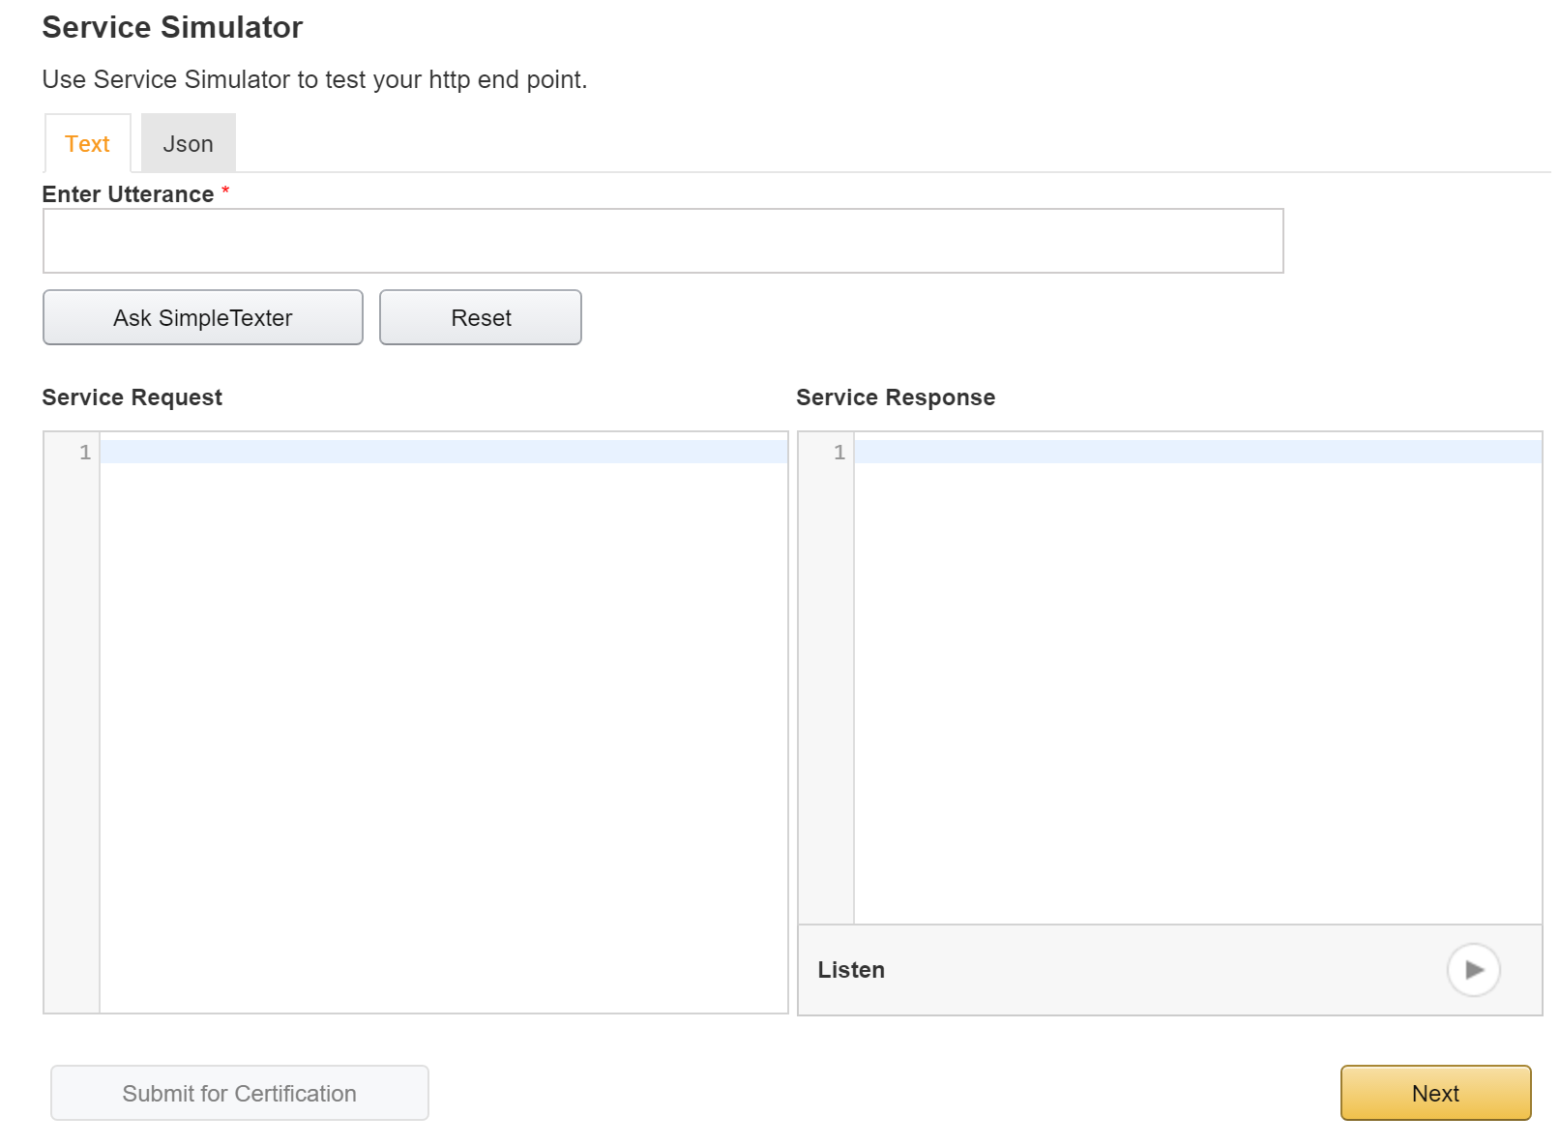
Then we test + play

Slide 14
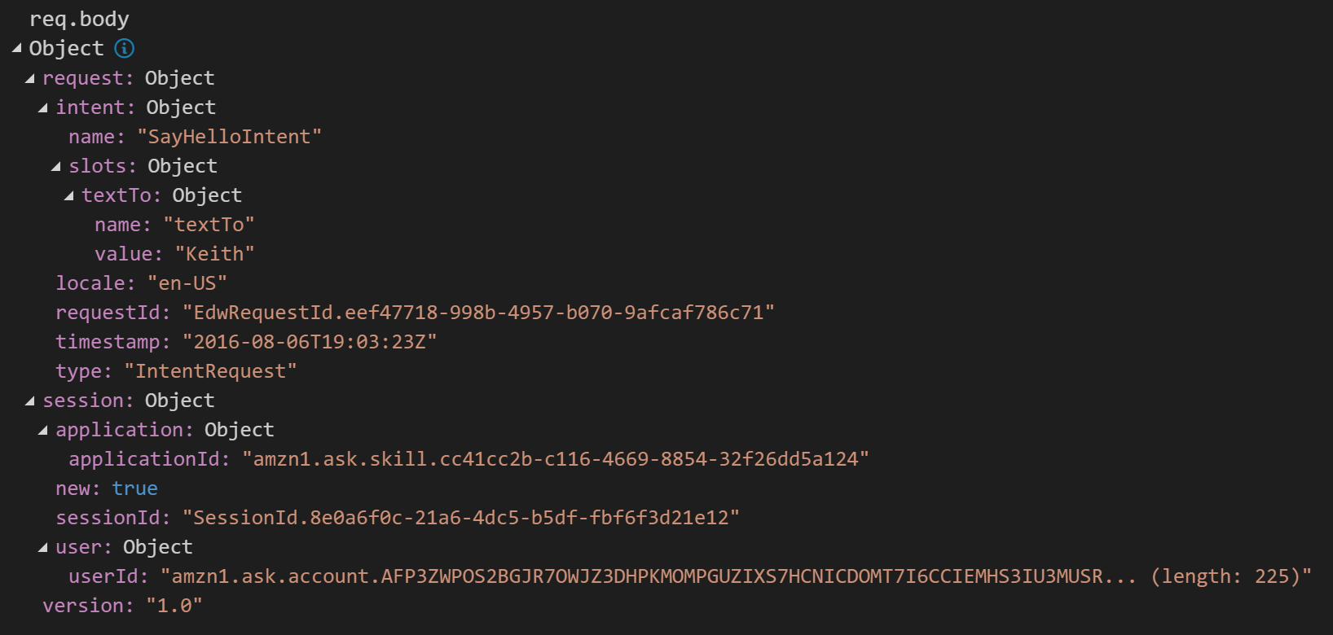
The Request

Slide 15
The Request
request
intent
name – which intent are we triggering
slots – obj
slotName : obj
name: name of slot
value : value
timestamp
requestId – not conversational – see session
session
application – obj
applicationId
new : bool – is this a continued session or a fresh one?
sessionId – used over a conversation
user : obj
userId – amazon account identifier

Slide 16
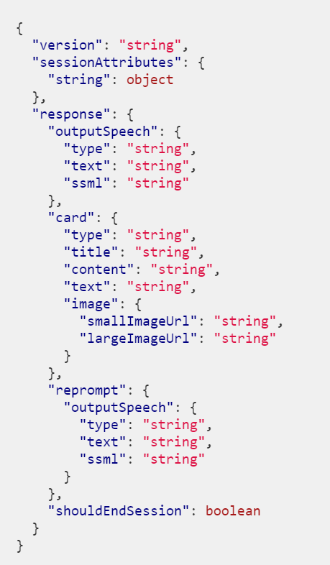
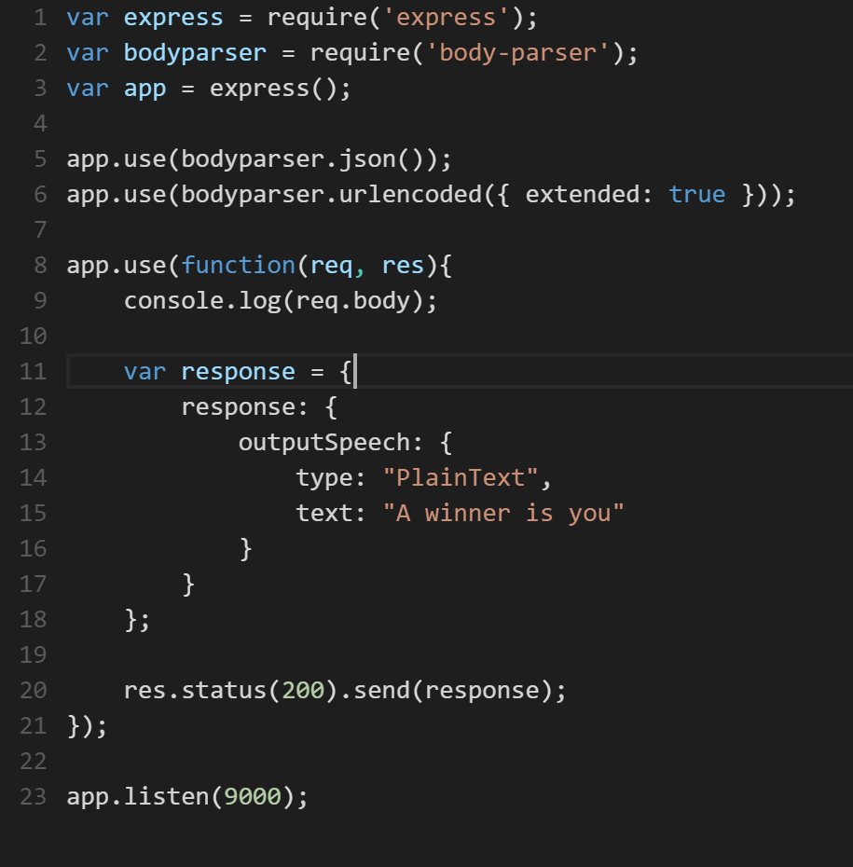
Expected response
possible
bare minimum

Slide 17
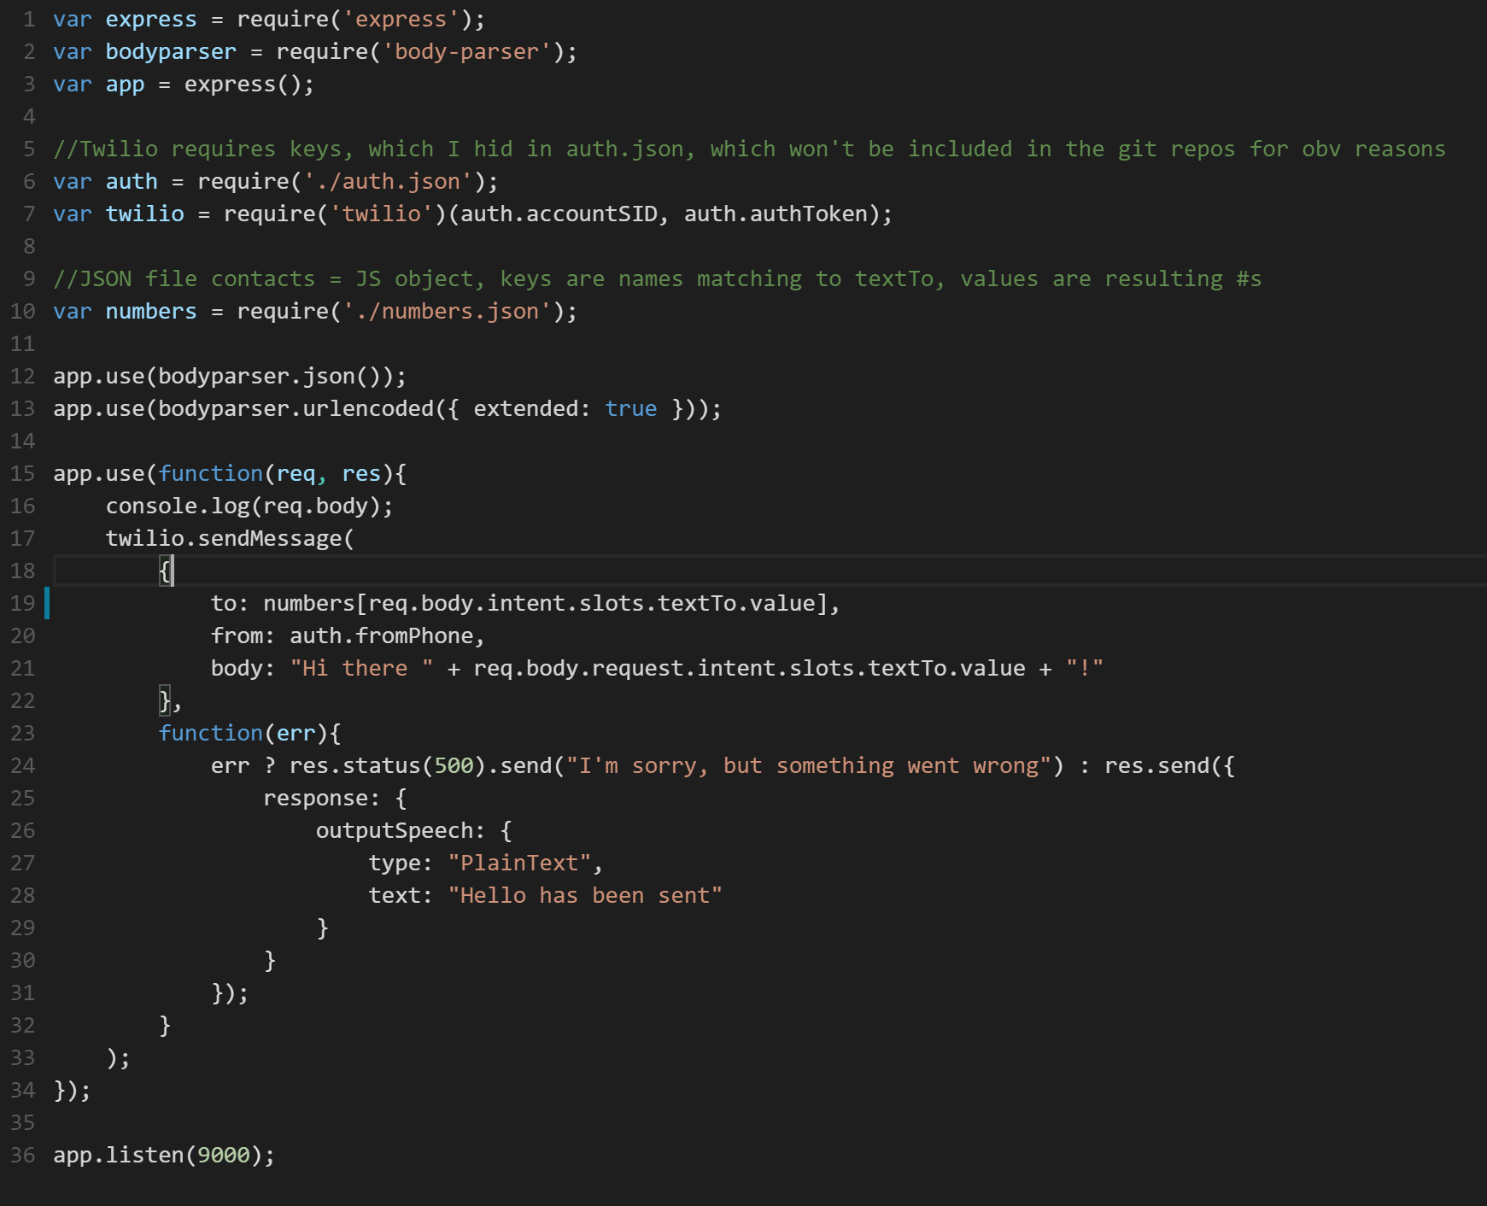
SimpleTexter

Slide 18
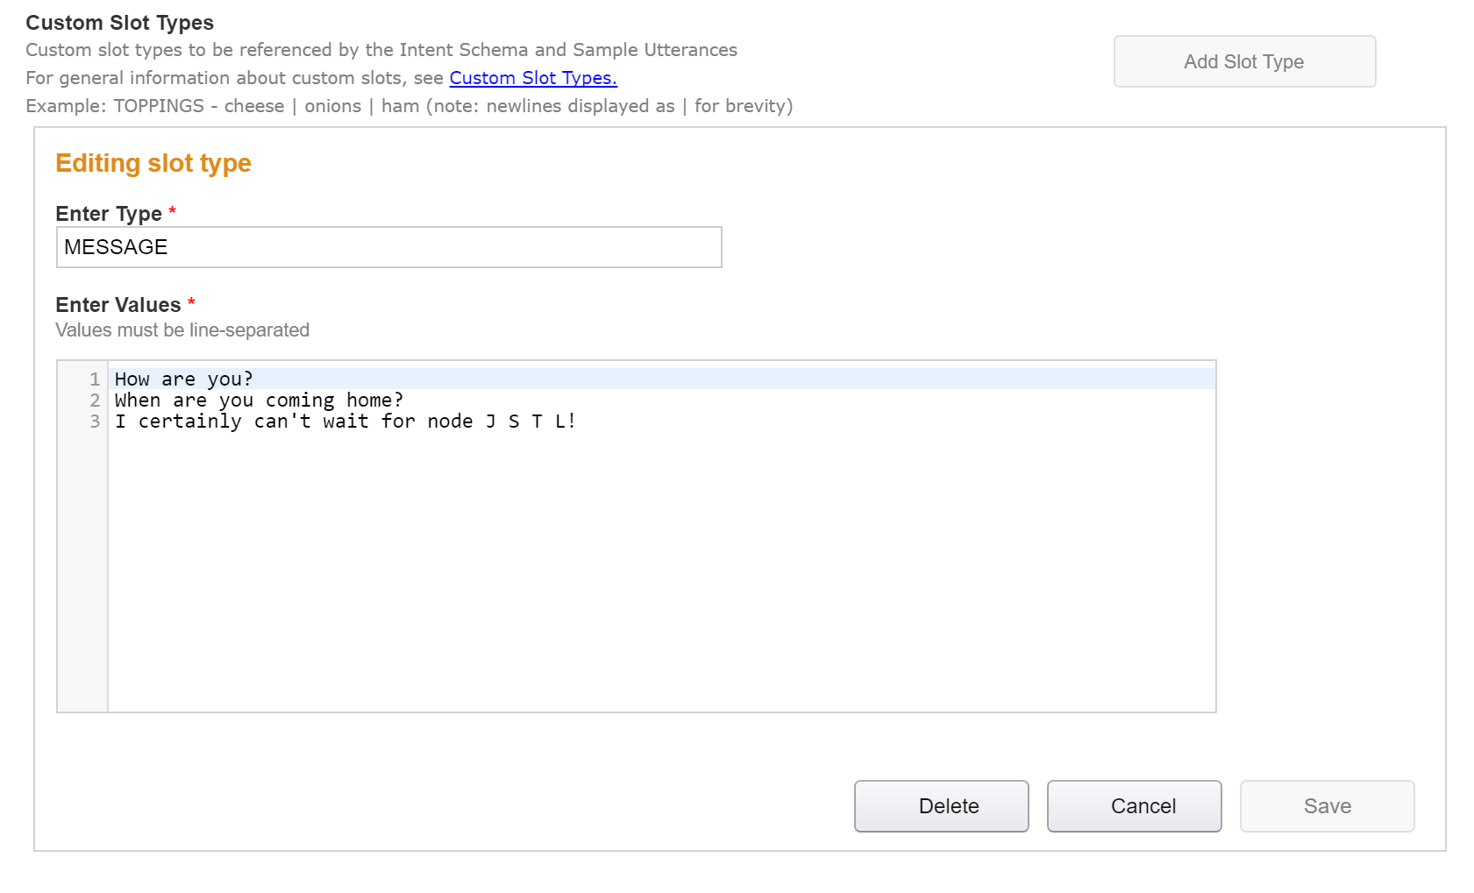
Making a custom slot

Slide 19
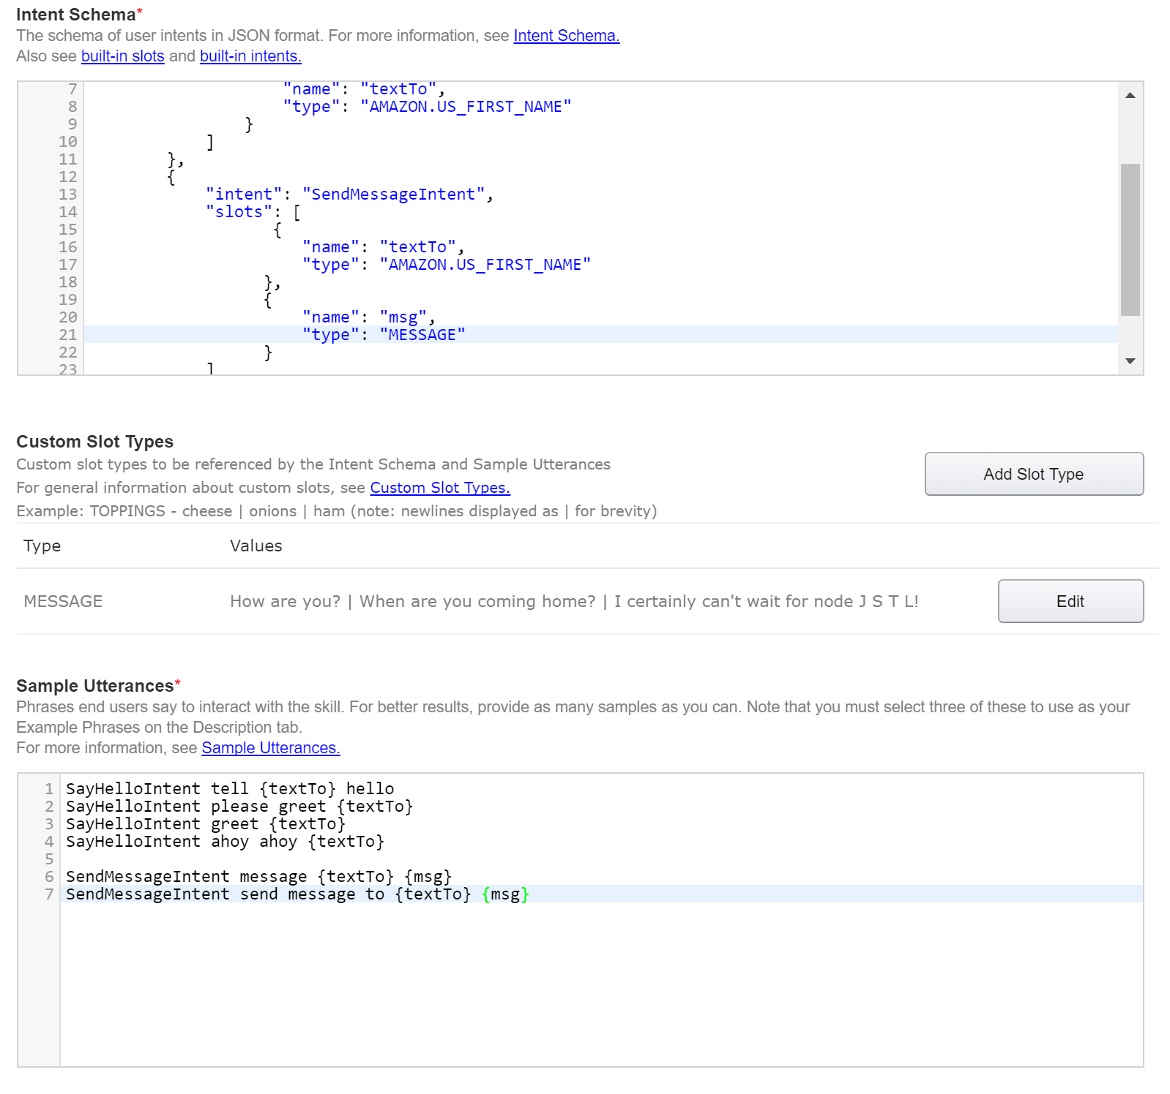
Expanding on simple texter

Slide 20
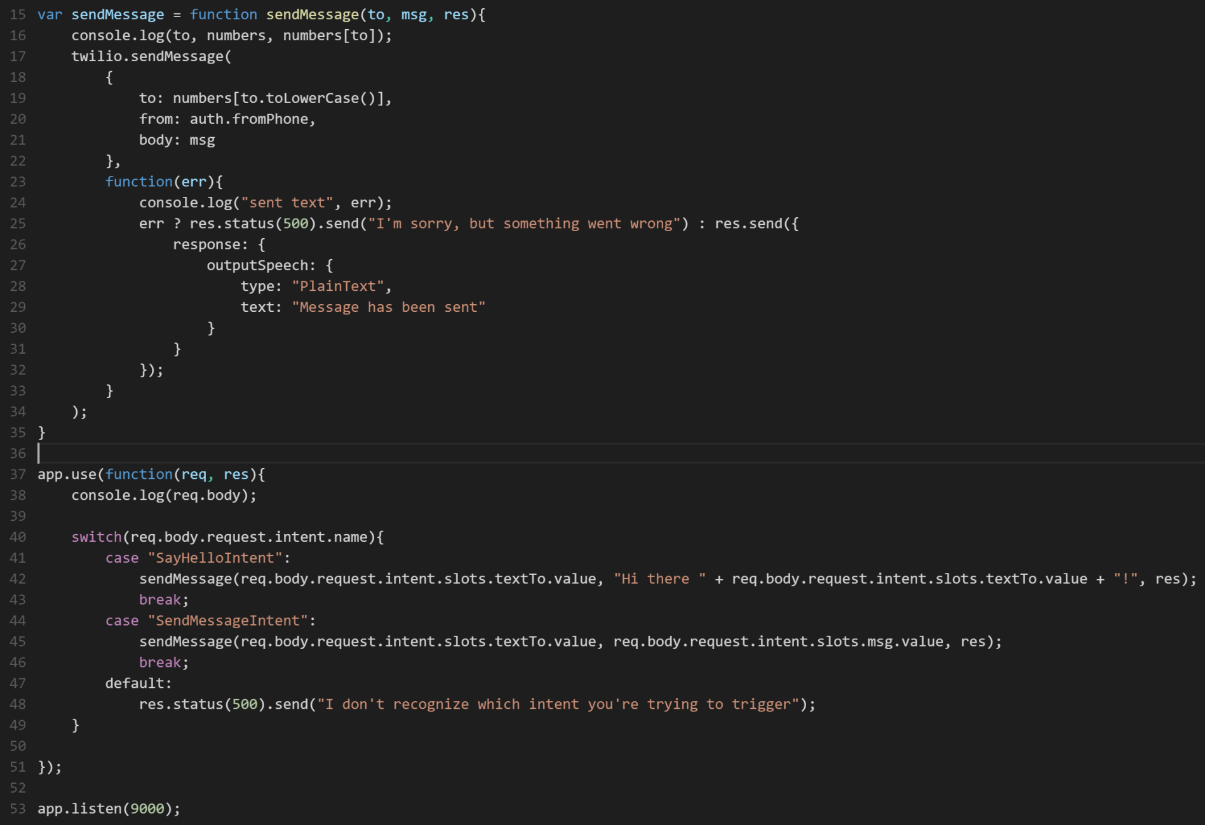
Advanced Texter

